Slide 4
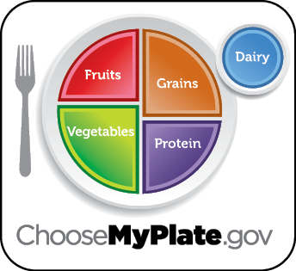
Mark done in the box when finished reading.
MyPlate is a tool to help build healthy eating patterns using the 5 food groups.
Similar foods like carrots and lettuce are grouped together. These foods are grown from seeds and are called vegetables. Each food group has different health benefits.

Slide 5
Mark done in the box when finished reading.
Eating foods from all food groups gives you healthy nutrients that your body needs to learn, play, and grow. Plan to eat from more than 1 food group for meals and snacks.
Ask to help with food preparation or cooking to learn about new foods and how to prepare them.

Slide 6
Check out this video!
Each food group has specific health benefits. On the next slide, see if you can match the correct health benefits to the food group by dragging it to the right box. When you’re done, put a check in the box.

Slide 7
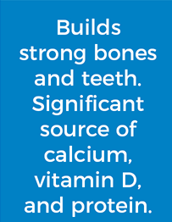
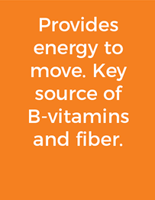
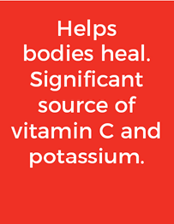
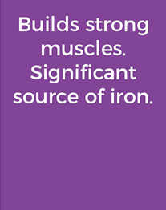

Slide 8
Using your senses (sight, touch, smell, taste, and hearing), investigate food at your next meal. Share your findings by completing the chart on the next slide. Use the examples below to help your investigation.
Sight: What is the shape, color, and size?
Touch: Is it smooth, bumpy, or rough?
Smell: Is there an odor or fragrance?
Taste: How does it taste? Salty? Sweet? Spicy?
Hearing: Does it crunch, pop, or snap?

Slide 9
What food did you investigate?
What senses did you use?
Describe the food here.

Slide 12
Instructions
On the next 2 slides a meal is shown. One food group is missing from each meal. Identify the missing food group and write the name of the group. What food could you add to complete the meal?

Slide 13
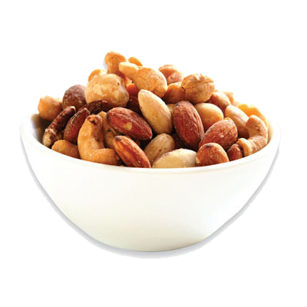
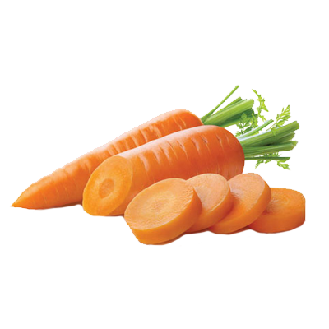
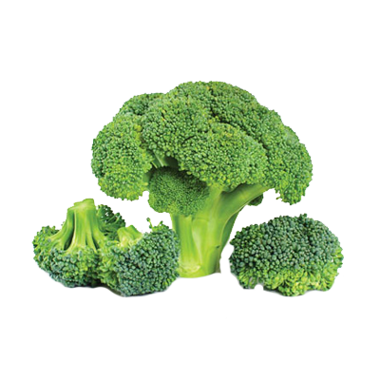
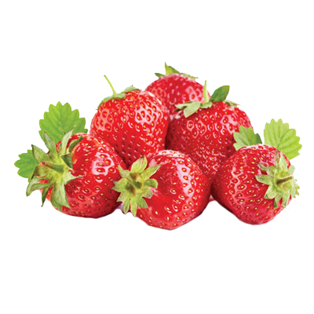
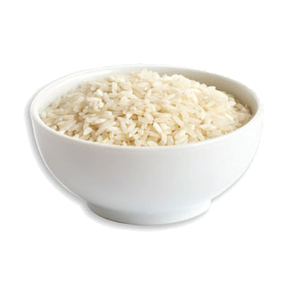
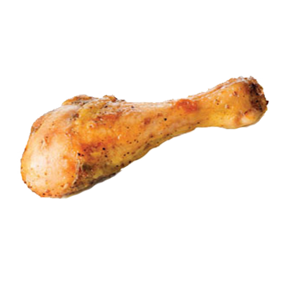
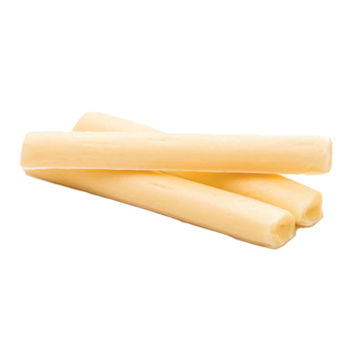

Slide 15
Instructions
On the next 2 slides a meal is shown. One food group is missing from each meal. Identify the missing food group and write the name of the group. What food could you add to complete the meal?

Slide 16
What food group is missing?
What food can you add?
Peanut butter and banana sandwich with a glass of milk

Slide 17
What food group is missing?
What food can you add?
Tacos with tortillas, hamburger, lettuce, tomato, and cheese

Slide 18
Using your knowledge of how to build a plate that includes all food groups, write 3–4 sentences about the importance of eating from ALL food groups.

Slide 21
What activities would you be willing to start doing at home? Drag your choices to the box on the right.

Slide 23
Instructions
On the next slide, drag a circle around 2 new foods you could try as a part of a meal or snack. When you have completed this activity put a check mark in the box.

Slide 24
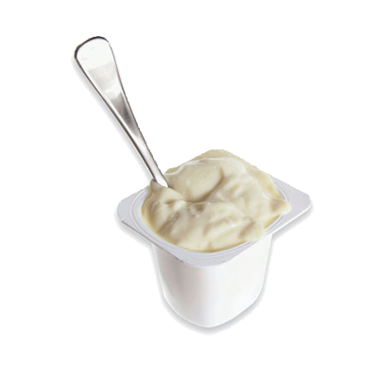
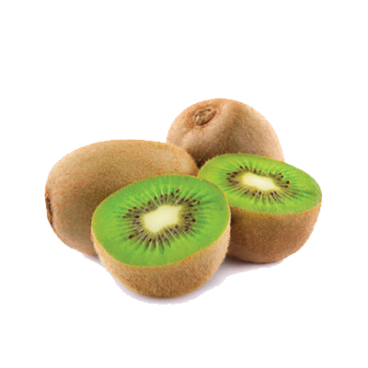
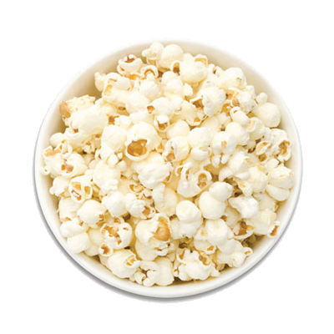
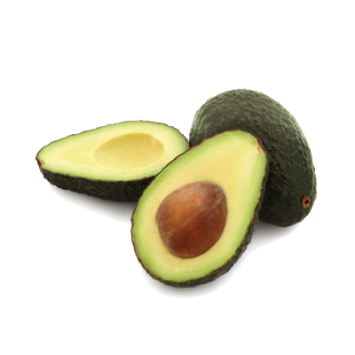
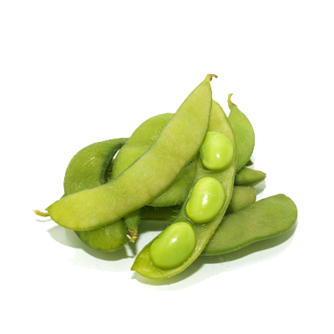
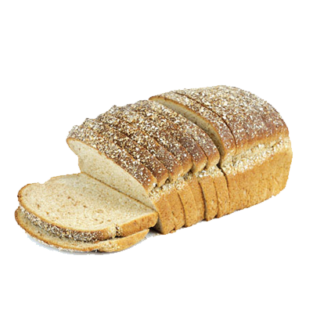
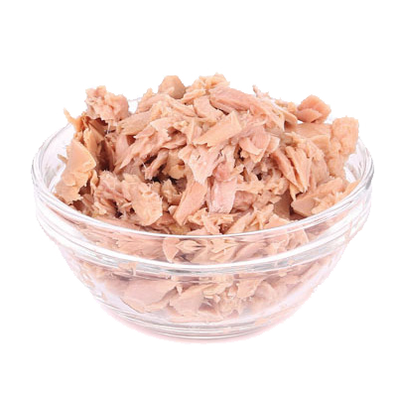
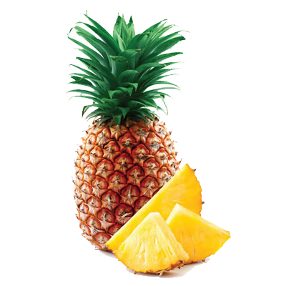

Slide 25
Think about a goal that you can create for yourself that is connected with trying new foods. You can use this sentence frame, “When we shop for food or when I eat my next meal, I will choose to try _______________________ as a new food.”

Slide 26
Supermarket Sweep
Take a piece of paper and list the 5 food groups (Dairy, Vegetables, Fruits, Grains, Protein). You can play alone or with a family member. Each player has 30 seconds to go find an item from a food group. Once you have items in each category, think of how you can create a meal using items from all the food groups.
Example:
You have 30 seconds to go find a food item and place it in the correct food group. You can bring back milk for the Dairy group. Next, you have 30 seconds to go find another item in 1 of the 4 remaining food groups. You can bring back bread for the Grains group. This continues until all 5 food groups are completed.

Slide 27
Household Item Sweep
You can also play with household items. Each food group helps the body. (Dairy builds strong teeth and bones; Vegetables help the skin and eyes; Fruits help the body heal; Grains give energy; Protein builds strong muscles.) You have 1 minute to go find a household item that does what each food group does for the body.
Example:
Toothpaste can represent Dairy since it helps with keeping your teeth strong. Glasses can represent the Vegetables group because vegetables help your eyes. Bandages can represent Fruits because fruits help you heal. Batteries can represent the Grains group because grains give you energy. A weight or heavy book can represent Protein because lifting heavy things can help build muscles.

Slide 29
Take this short Knowledge Check to share what you learned.

